Slide 1


Electricity Load Forecasting Using Machine Learning and Time Series Models
Exploring predictive models to improve energy demand forecasting for grid management and sustainability.
by Yash Raj

Slide 2

Background: Importance of Electricity Load Forecasting
1
Critical for Grid Management
Accurate forecasting enables efficient energy planning.
2
Tackle Demand Fluctuations
Capture seasonal and external factors influencing consumption.
3
Leverage ML and Time Series
Models to predict trends and patterns in energy data.

Slide 3

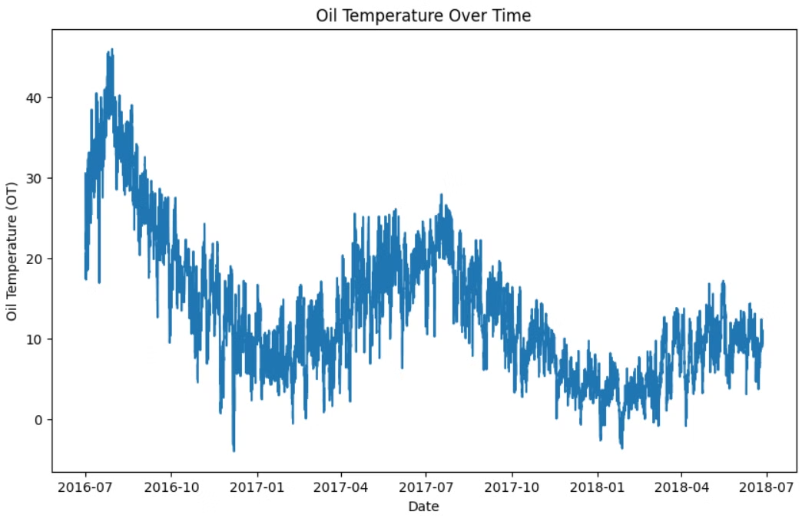
Data Preprocessing and Exploratory Data Analysis
1
Data Preprocessing
Loaded dataset, handled missing data, converted to datetime.
2
Exploratory Analysis
Plotted consumption trends, observed daily/weekly/seasonal patterns.

Slide 4
Models and Feature Engineering
Models
Feature Engineering
Objectives
Prophet, LSTM, Linear Regression, ARIMA, Chronos
Lag features, rolling averages, percentage changes
Capture seasonality, trends, and non-linear patterns

Slide 5
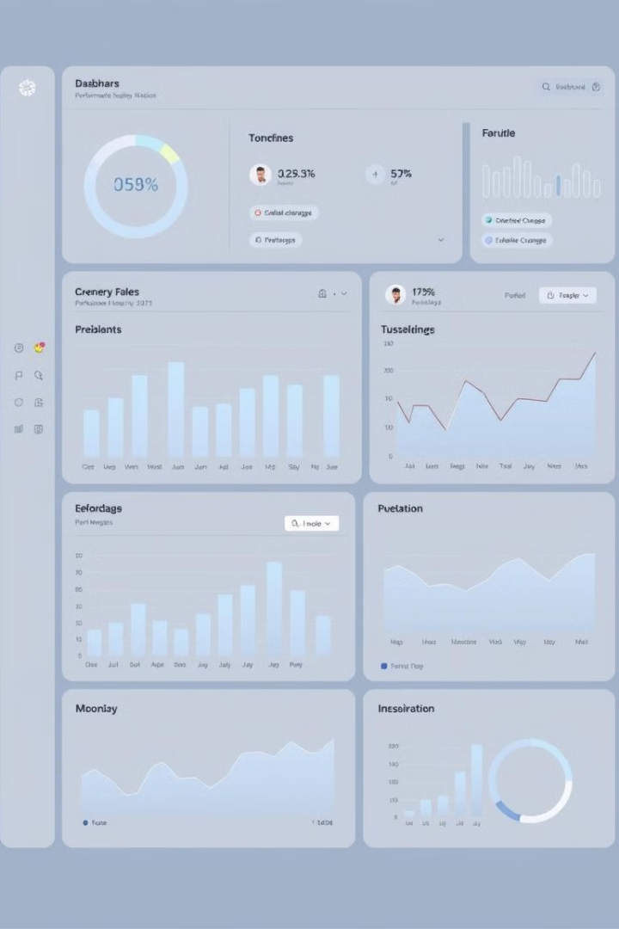
Evaluation Metrics
MSE
Measure of prediction accuracy
MAE
Average magnitude of prediction errors
R² Score
Goodness of fit for the models

Slide 6

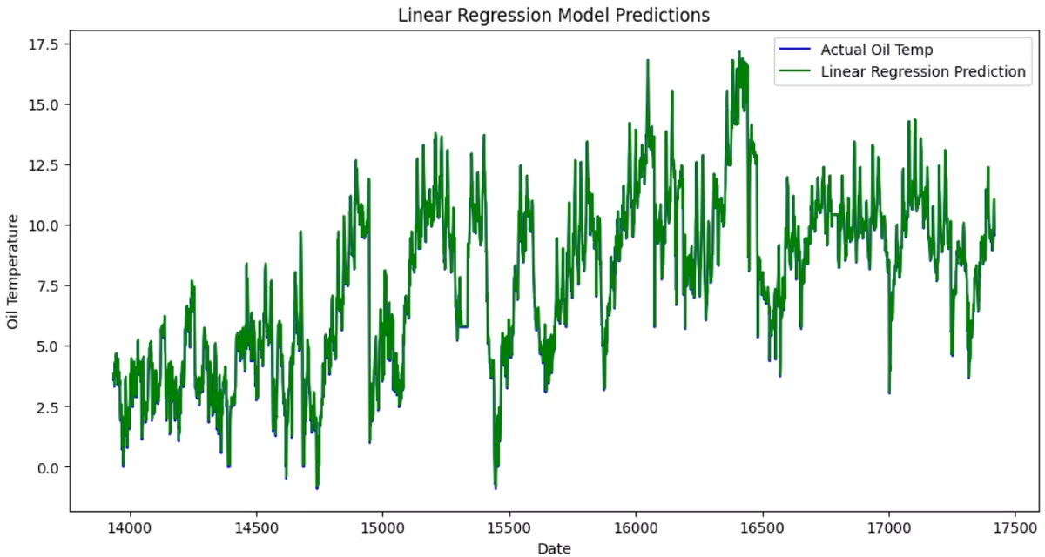
Model 1: Linear Regression
1
Baseline Model
Predicted trends using historical data
2
Results
MSE: 0.43, MAE: 0.45, R²: 0.9640
3
Analysis
Captured trends well but struggled with non-linear patterns

Slide 7

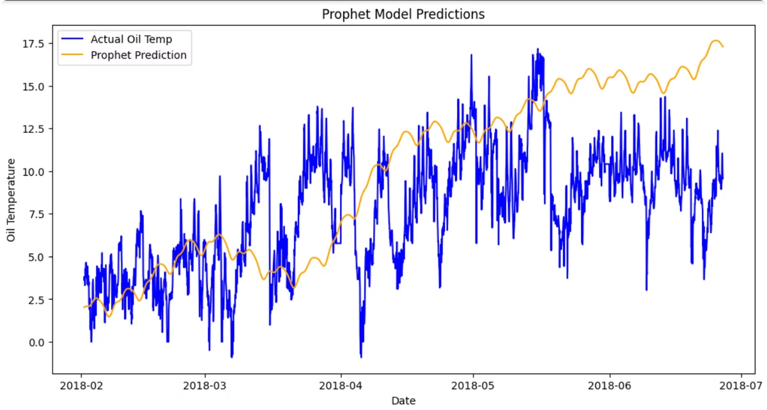
Model 2: Prophet
Seasonal Modeling
Effectively captured seasonality and long-term trends
Results
MSE: 20.96, MAE: 3.72, R²: -0.7651
Analysis
Struggled with volatile demand peaks, but handled missing data well

Slide 8

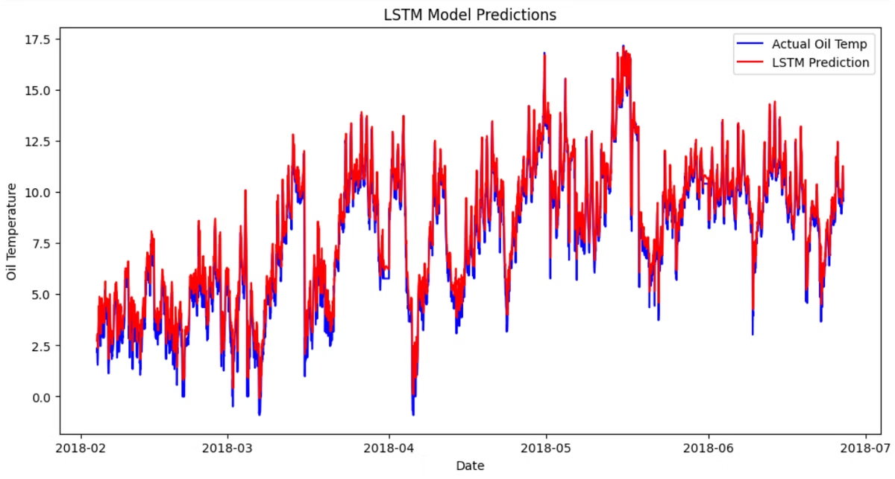
Model 3: LSTM
1
Capture Dependencies
Designed to model short- and long-term dependencies
2
Results
MSE: 0.60, MAE: 0.58, R²: 0.9481
3
Analysis
Performed well on complex patterns but required significant tuning

Slide 9

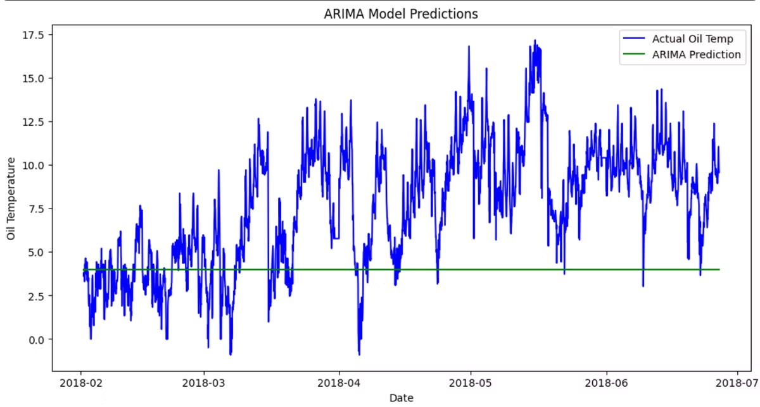
Model 4: ARIMA
Traditional Model
Forecasted linear trends and seasonality
Results
MSE: 25.80, MAE: 4.22, R²: -1.1730
Analysis
Struggled with non-stationary, highly fluctuating consumption data

Slide 10


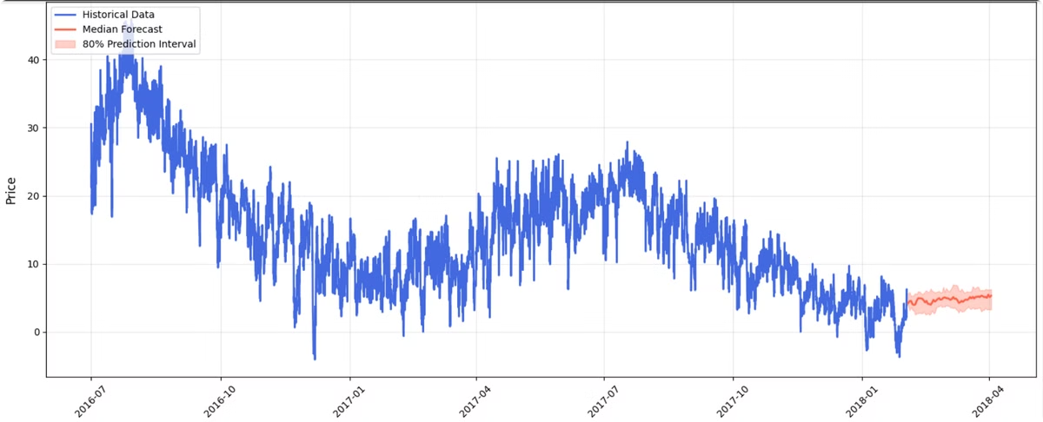



Model 5: Chronos
Best Performance
Delivered the most accurate predictions
Captured Complexity
Effectively modeled intricate consumption patterns
Challenges
High volatility and computational costs
Future Work
Explore ensemble methods and external factors

Slide 11

Hypotheses for Model Improvements
Exploring ways to enhance the accuracy and performance of our electricity load forecasting models.

Slide 12

Results of Hypothesis 1
Incorporating technical indicators like rolling averages improved the accuracy of Prophet and Chronos models.
1
Capturing Long-Term Trends
The additional features helped the models better identify long-term trends, especially for seasonal and holiday-related demand spikes.
2
Improved Accuracy
The models demonstrated enhanced predictive performance, with reduced mean squared error and improved R-squared scores.
3
Challenges Remain
While the results were promising, the models still struggled to fully capture the high volatility and sudden changes in energy consumption.

Slide 13
Results of Hypothesis 2
LSTM vs Traditional Models
Improved Predictions
Computational Costs
LSTM's ability to model complex temporal dependencies in the data led to more accurate predictions compared to the linear ARIMA model.
While the LSTM achieved better performance, it required substantially more computational resources and training time than the traditional ARIMA approach.
The LSTM model outperformed the traditional ARIMA model in sequential pattern handling and long-term forecasting of electricity load.

Slide 14

Summary and Future Outlook
Our electricity load forecasting journey has yielded valuable insights, with the Chronos deep learning model delivering the most accurate predictions. However, we still face challenges with high volatility and computational costs associated with advanced models.
Moving forward, we plan to explore ensemble methods, hybrid approaches, and incorporating external factors like weather and holidays to further enhance the accuracy and robustness of our forecasting capabilities.

